Slide 1
E-Commerce Sales Dashboard
Power BI Project with Insights and Prompt

Slide 2
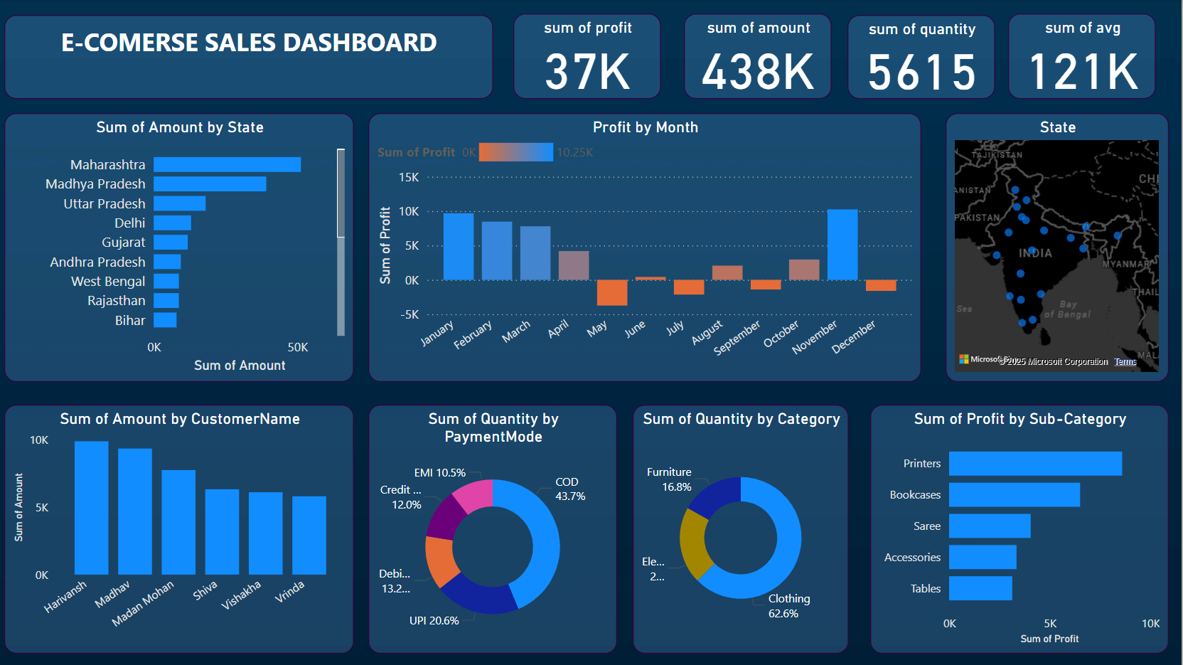

Slide 3
Project Prompt and Overview
Prompt:
Create an interactive Power BI dashboard showcasing key metrics for an e-commerce platform, such as sales performance, profits, product categories, customer contributions, and payment modes.
Overview:
- Visualizes sales by state, customer, and sub-category
- Tracks monthly profit variations
- Displays mode of payments and product categories
- Includes a map for geographic insights
Key KPIs:
- Total Profit: 37K
- Total Sales Amount: 438K
- Quantity Sold: 5615
- Average Sales: 121K

